Slide 1



SAP Process Integration
(SAP PI)
Day 1
16th – 20th
March 2020
Trainer: Gopal
Kirti

Slide 2


Contents
1
What is SAP PI
Why do we need SAP PI
SAP PI Versions
SAP PI Installation options
2
3
4
5
Runtime engines in SAP PI
SAP PI Architecture
SAP PI Components
6
7
Copyright © Capgemini 2016 All Rights Reserved
2

Slide 3
What is SAP PI
SAP NetWeaver Process Integration (SAP PI) is SAP’s enterprise application integration(EAI) software.
SAP PI is a NetWeaver product group used to facilitate the exchange of information among a company's internal software and systems and those of external parties.
It takes the responsibility of integrating different SAP and non-SAP systems in the Heterogeneous Landscape (network of different computers).
Earlier it was called as XI (Exchange Infrastructure) and from PI 7.0 it is called
PI (Process Integration).
Copyright © Capgemini 2016. All Rights Reserved
3

Slide 4
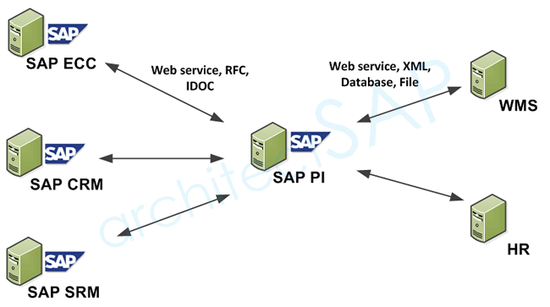
What is SAP PI

Slide 5
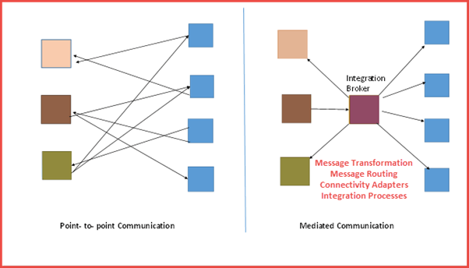
Why do we need SAP PI
Issues with point-to-point communication
Change in one system impacts all other connected systems.
High cost of maintenance
No traffic control mechanism
Less scalable and less scope for process innovation
Copyright © Capgemini 2016. All Rights Reserved
6

Slide 6
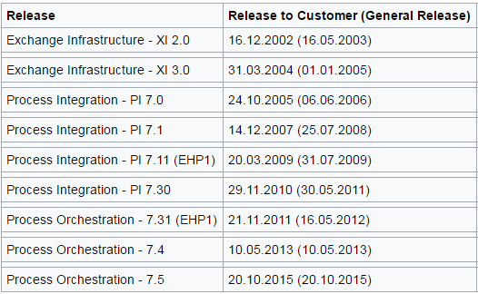

SAP PI Versions
SAP or 3rd party Cloud
Systems
SAP or 3rd party On-
SAP o 3rd Cloud
Systems
Copyright © Capgemini 2016. All Rights Reserved
7

Slide 7
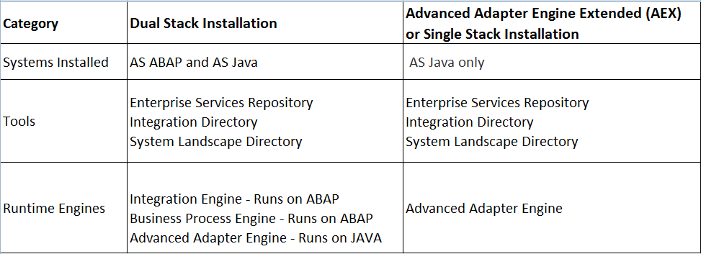
SAP PI Installation options
Copyright © Capgemini 2016. All Rights Reserved
9

Slide 8
SAP PI Installation options
Prior to SAP PI 7.3 release, dual-stack is the only option available.
Single stack installation is available only from SAP PI 7.3 release.
Process Orchestration(SAP PI + NW BPM + NW BRM) option is available only from SAP PI 7.31 release
Process Orchestration(SAP PO) which bundles PI, NW BPM and NW BRM can be installed on a single SID only for Java-only installation of AEX. If its dual stack installation, BPM has to be installed on a separate SID.
Copyright © Capgemini 2016. All Rights Reserved
9

Slide 9
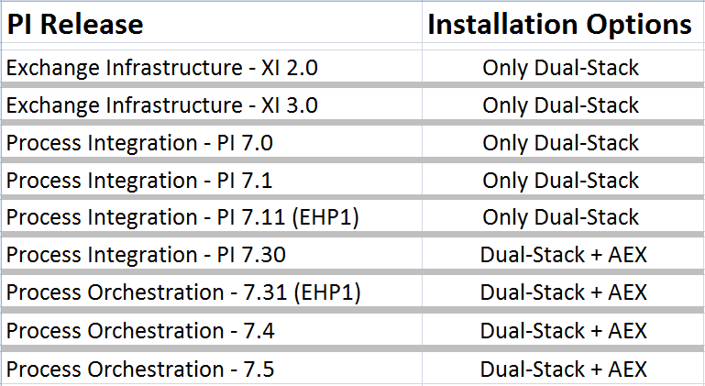
SAP PI Installation options
Copyright © Capgemini 2016. All Rights Reserved
9

Slide 10
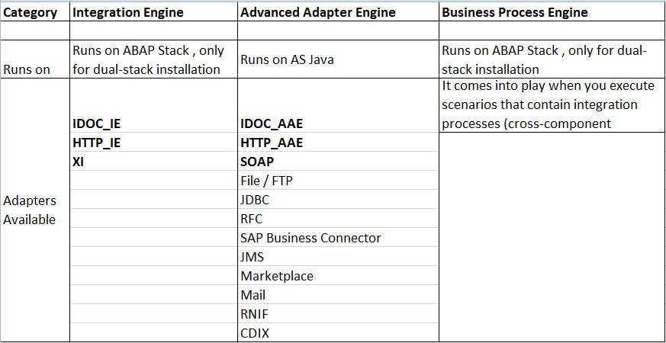
Runtime engines in SAP PI
Copyright © Capgemini 2016. All Rights Reserved
9

Slide 11
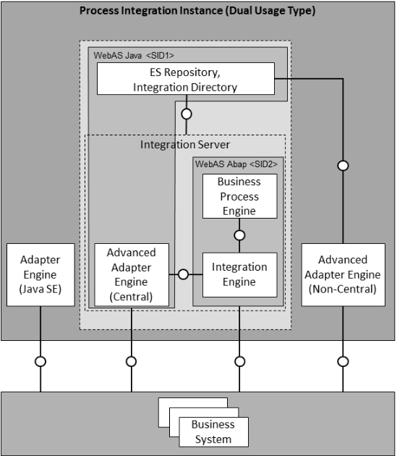
SAP PI Architechture
DUAL STACK
Copyright © Capgemini 2016. All Rights Reserved
10

Slide 12
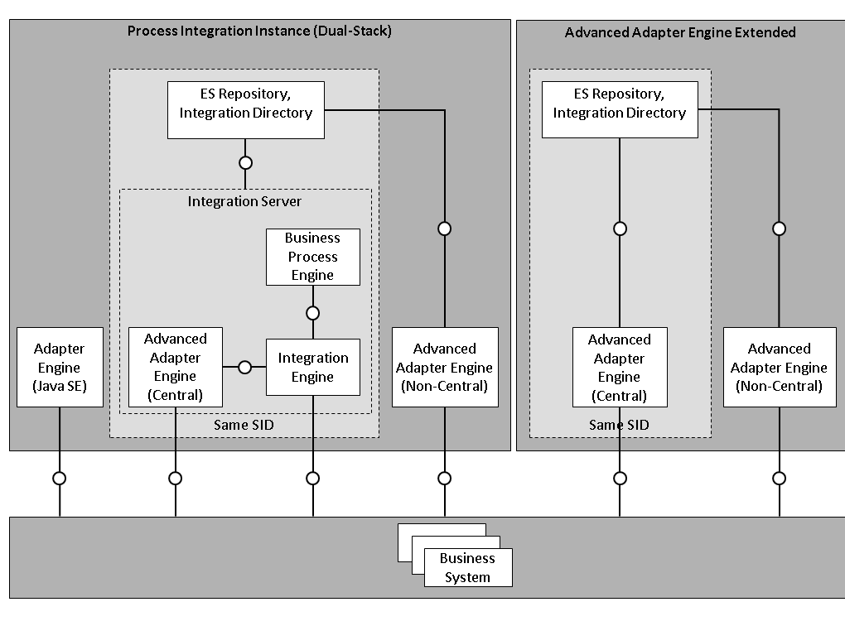
SAP PI Architechture
DUAL STACK
SINGLE STACK
Copyright © Capgemini 2016. All Rights Reserved
10

Slide 13
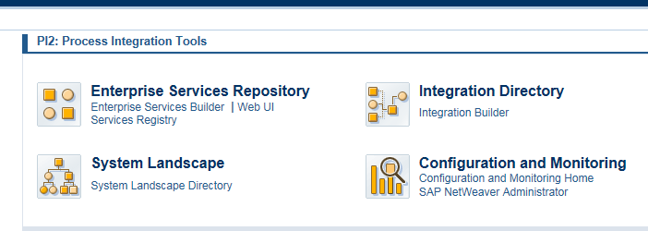
Introduction to SAP PI Components
System Landscape Directory
Enterprise Services Repository – Design Time objects
Integration Directory – Runtime Objects
Configuration and Monitoring – Monitoring
Copyright © Capgemini 2016. All Rights Reserved
10

Slide 14
Thank you !!
Lets smile ☺

